Slide 1

SYNOPSIS PRESENTATION
Topic:- E-HOSPITAL
By:- Priyanka Pandey
Under the supervision of :-
Dr. Shashank Bhardwaj
Department Of Computer Applications
KIET GROUP OF INSTITUTIONS, DELHI-NCR, GHAZIABAD-201206 ( 2023- 2024)

Slide 2
INTRODUCTION
The project E-Hospital includes registration of patients, storing their details into the system, and also computerized billing in the pharmacy, and labs. The software has the facility to give a unique id for every patient and stores the details of every patient and the staff automatically. It includes a search facility to know the current status of each room. User can search availability of a doctor and the details of a patient using the id.
Background: The increasing number of patient visits in primary healthcare centers causes long duration of queue in a registration counter. To solve this problem, we have created an online registration system in each health service provider. The e-health is expected to give a positive impact on reducing the queue traffic at the registration counter.

Slide 3
TECHNOLOGIES USED
Web-based technology
HTML
Allows the user to produce web pages that include text, graphics and hyperlinks
Integrated JSP
Structure text-based information in a document
Javascript
JDK 1.8
Java is secure, fast, and reliable.
It can be used from laptops to data centers, game consoles to scientific supercomputers, or cell phones to the internet
JRE 1.8
It is a JAVA runtime environment to basically run the Java Application and the system
Mysql server
Mysql server is used for database connectivity and management
Function
Storing
Retrieving of data requested by software applications
CSS(Cascading Style Sheets)
It is a style sheet language
Used for describing the presentation of the document in a written markup language

Slide 4
SCOPE
The system will be used as the application that serves hospitals, clinic, dispensaries or other health institutions. The intention of the system is to increase the number of patients that can be treated and managed properly.
If the hospital management system is file based, management of the hospital has to put much effort on securing the files. They can be easily damaged by fire, insects and natural disasters. Also could be misplaced by losing data and information.
It will allow online storage of data so that medical reports can be accessed anywhere irrespective of geographical loccations.

Slide 5
SYSTEM SPECIFICATIONS
Hardware Requirement:-
Laptop
Wi-fi router
2GB to 4 GB RAM
Core i5 processor
Software Requirements:-
Windows 7 or above operating system
JDK 1.8, JRE 1.8
Mysql server
Web Browser

Slide 6
S.No. | MODULE NAME | APPLICABLE ROLES | DESCRIPTION
1. | LOGIN | PATIENT,DOCTOR, ADMIN | PATIENT: Can login using unique Id and Password after this system shall show his/her profile. DOCTOR: Can login using unique Id and Password after this system shall show his/her profile. ADMIN: Can login using unique Id and Password after this system shall show a profile with links to maintain the website.
2. | REGISTRATION | PATIENT | PATIENT: Can Register by filling all the required details, after this the system will verify the details and check if already registered or not.
3. | MAKE APPT. | PATIENT | PATIENT: Can Select doctor, date time and make an appointment request after this system shall show a confirmation for appointment request.
4. | CANCLE APPT. | PATIENT, DOCTOR , | PATIENT : Can Cancel appointment if want to by just one click after this system shall ask for re-schedule or refund of payment. DOCTOR : Can Cancel appointment if want to by just one click after this system shall send a message to the patient.

Slide 7
5. | PAYMENT | PATIENT | PATIENT : Enter payment details and make payment after this system shall show the generated bill by the hospital.
6. | DOCTOR MODULE | ADMIN | ADMIN : Can add a new doctor by filling all the details after this system shall show a confirmation message. Can Remove a doctor by just one click after this system shall show confirmation message.
7. | PATIENT MODULE | PATIENT | PATIENT : Can view payment history or can search for a particular bill also after this system shall show a bill or history. Can also See or search for a doctor by entering dept. name or doctor id if known after this system will check for the doctor if found shall show doctor’s profile. Can also update details after this system shall ask for re-enter password and after verifying password shall update details.
8. | ADD PRESCRIPTION | DOCTOR | DOCTOR : Enter Patient Id and after this all the treatment details and medicine, remark and advice for the patient after this system shall show a message for update.

Slide 8

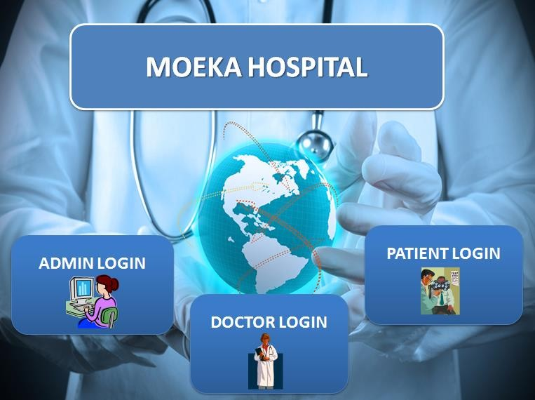
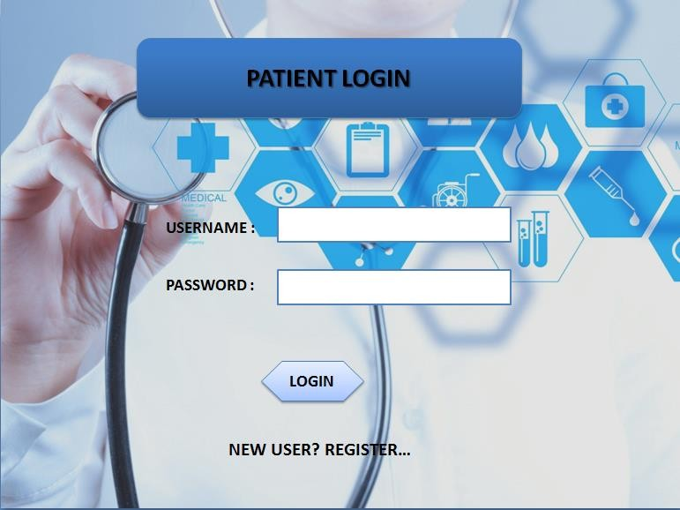
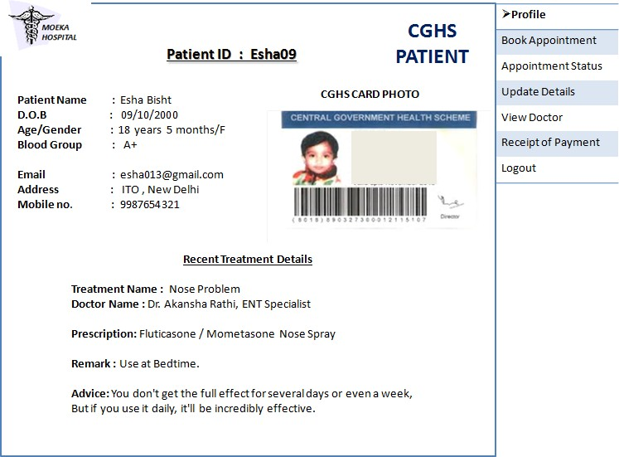
OUTPUT

Slide 9
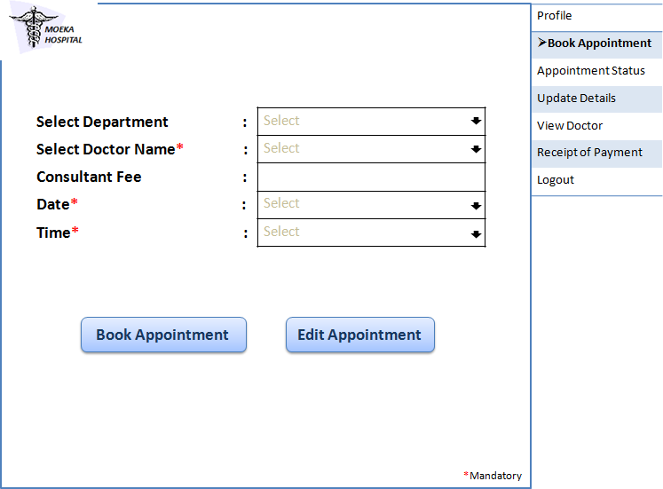
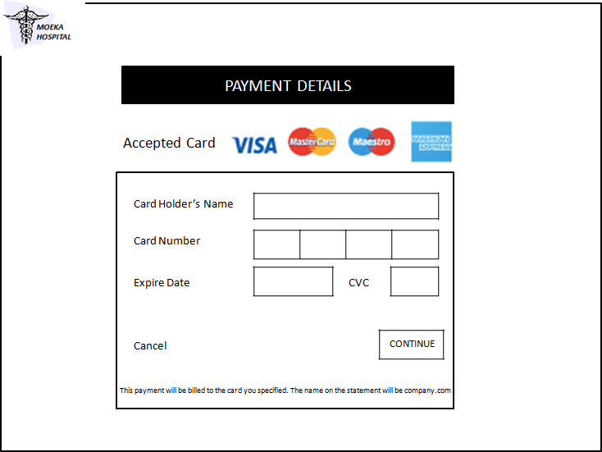
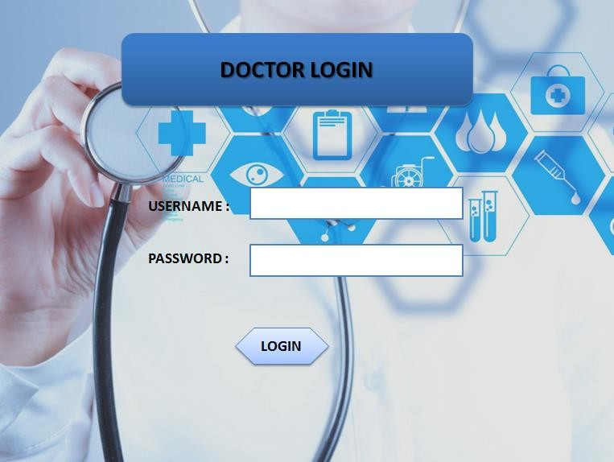
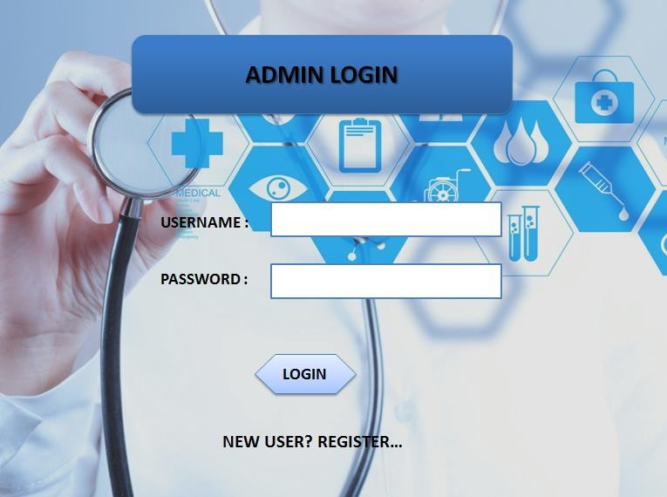

Slide 10
CONCLUSION
The system is designed to provide an integrated set of solutions that enable hospitals to effectively manage their operations, improve patient care and streamline administrative tasks.
It can provide an integrated, comprehensive solution to managing patient records, billing and scheduling, as well as provide real-time insights into hospital performance.

Slide 11
REFERENCES
https://www.adroitinfosystems.com/products/ehospital-systems/#:~:text=Patient%20Registration%20module%20of%20eHospital,%2C%20employer%2C%20and%20insurance%20information.
https://mscw.ac.in/NAAC/Criteria1/Samples-of-ProjectWork_Fieldwork/Computer_Science/software_Engineering/Software%20Engineering/Hospital%20Managment%20Project%20SE-converted.pdf
https://skill-lync.com/student-projects/project-design-a-hospital-management-system-4

Slide 12
THANK YOU

